Slide 1

A Toast to You!
2021

Slide 2
NAWBO
Iowa
NAWBO Iowa propels women entrepreneurs into economic, social & political spheres of influence statewide.

Slide 3

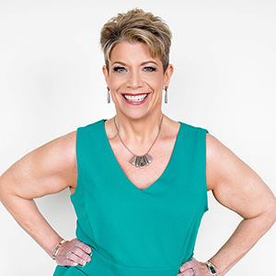

Angie
Chaplin
Mindful Leadership
1
YEAR
Alignment

Slide 4

Stephanie
Hill
Light Bulb Moment Consulting
1
YEAR
Hope

Slide 5
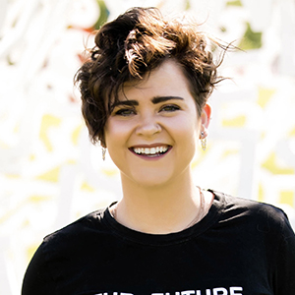
Ashley
Hunt
IAstrategies
1
YEAR
Impact

Slide 6

Karla
Rendall
Rendall Insurance Agency
5
YEARS
Freedom

Slide 7
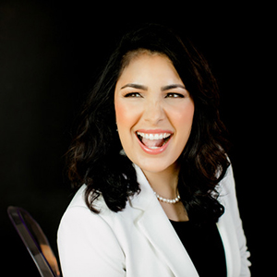
Claudia
Schabel
Schabel Solutions
5
YEARS
Impact

Slide 8
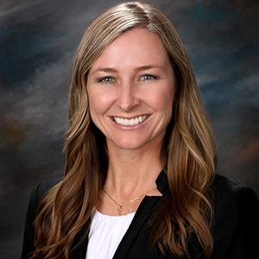
Rebecca
Albers
Wells Fargo Advisors
10
YEARS
Flexible

Slide 9
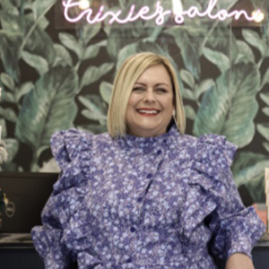
Tricia
Rivas
Trixies Salon
10
YEARS
Create

Slide 10
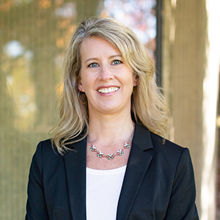
Lori
Vande Krol
Life Made Simple
15
YEARS
Alignment

Slide 11
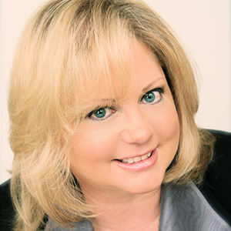
Jayne
Armstrong
U.S. Small Business Administration
25
YEARS
Advocacy

Slide 12
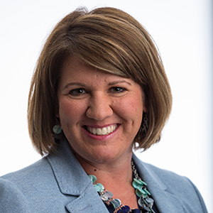
Courtney
DeRonde
TDT CPAs and Advisors PC
45
YEARS
Impact

Slide 13
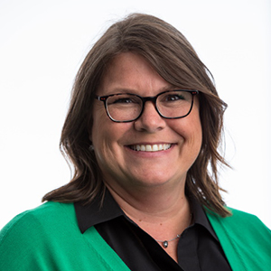
Monica
Sullivan
TDT CPAs and Advisors PC
45
YEARS
Passion

Slide 14
UP NEXT:
COFFEE & CONVERSATION – 11.12
LUNCH PROGRAM @ HYPERION – 12.1

