Slide 1


Slide 2


Slide 3
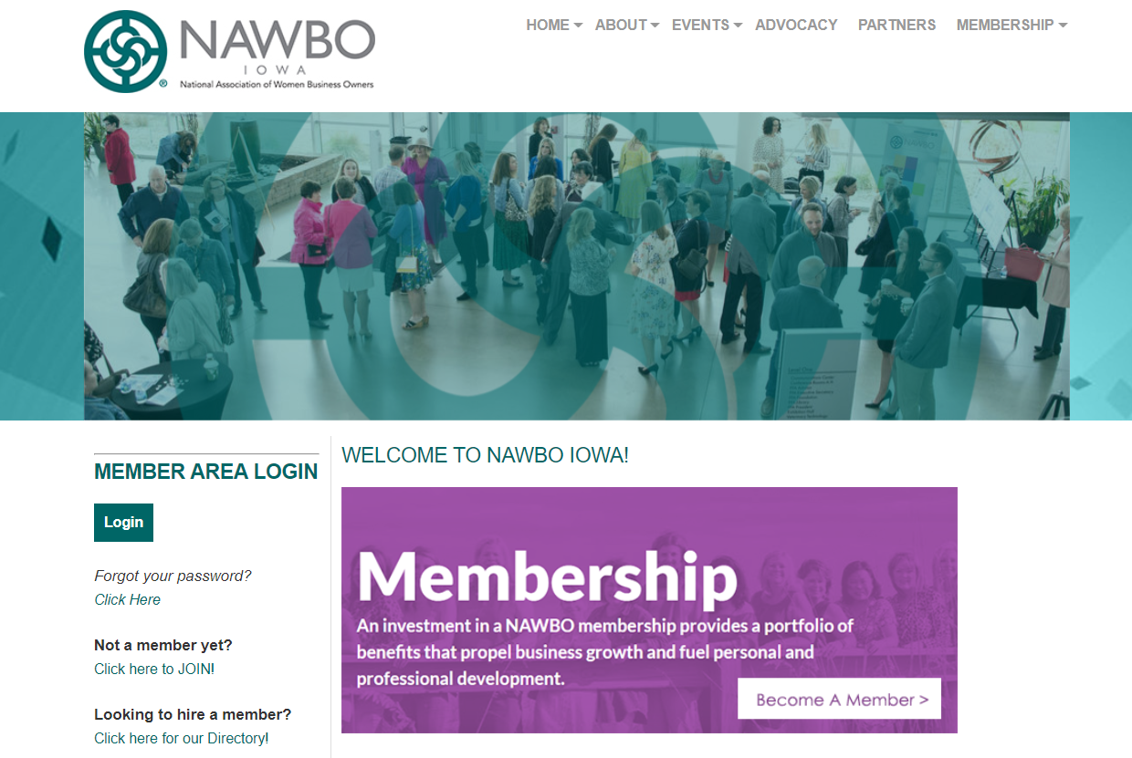
NAWBOIOWA.ORG

Slide 4
NAWBO Vision & Mission
The National Association of Women Business Owners (NAWBO) propels women entrepreneurs into economic, social and political spheres of power worldwide by:
Strengthening the wealth creating capacity of our members and promoting economic development within the entrepreneurial community
Creating innovative and effective change in the business culture
Building strategic alliances, coalitions and affiliations
Transforming public policy and influencing opinion makers

Slide 5


Slide 6


Slide 7


Slide 8


